Slide 1
Layoff Data visualization
Aiswarya
Bhavesh Bhagat
Deepanshi
Shanila Ali
Sharmi

Slide 2
Data set
Kaggle – Layoffs Dataset 2022
https://www.kaggle.com/datasets/theakhilb/layoffs-data-2022
2. Size of data – (1809, 12)
3. Names of columns - ['Company', 'Location', 'Industry', 'Laid_Off_Count', 'Percentage', 'Date', 'Source', 'Funds_Raised', 'Stage', 'Date_Added', 'Country','List_of_Employees_Laid_Off']

Slide 3

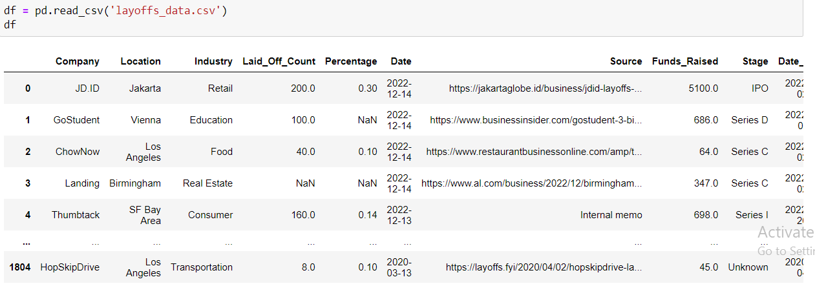
Including libraries and reading dataset
Reading CSV file

Slide 4

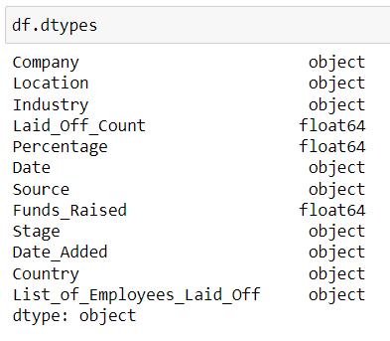
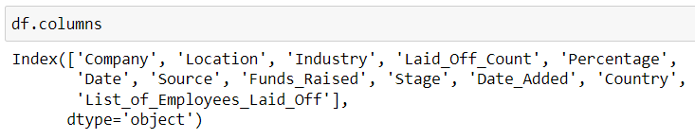
Data Exploration
Data wrangling is the process of removing errors and combining complex data sets to make them more accessible and easier to analyze.
Understanding size of data
2. Checking columns and datatypes of each column.

Slide 5
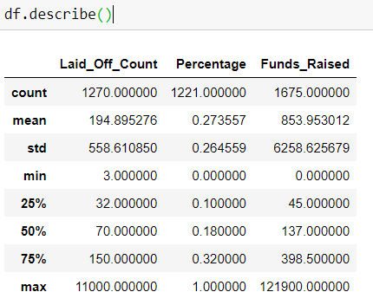
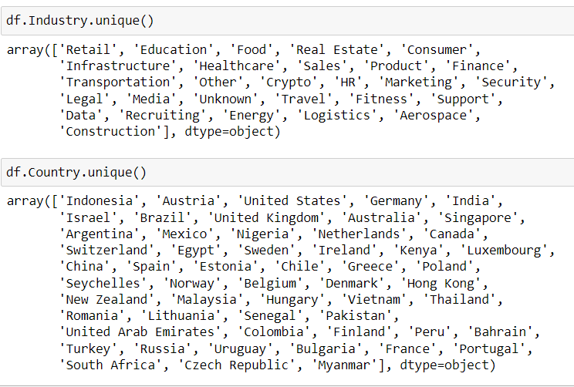
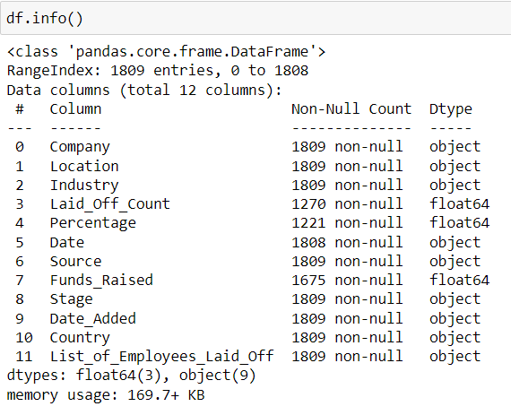

Slide 6
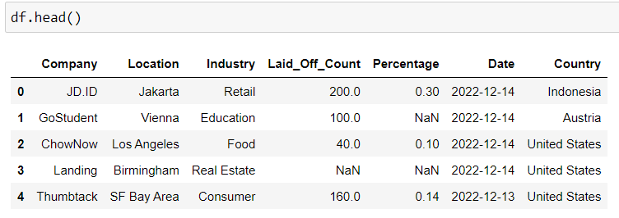
Data Cleaning
Data cleaning is the process of fixing or removing incorrect, corrupted, incorrectly formatted, duplicate, or incomplete
data within a dataset.
1. Removing few columns

Slide 7
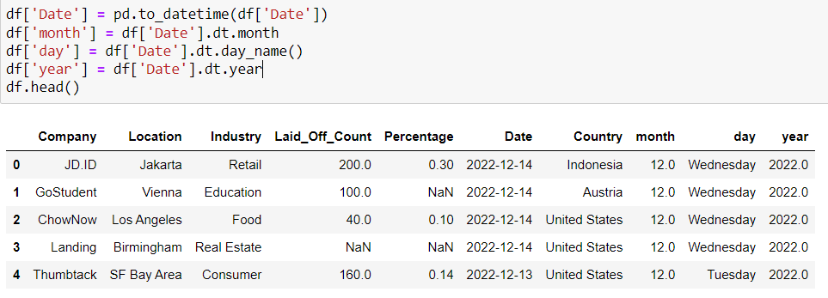
2. Splitting date in Year, months and days

Slide 8
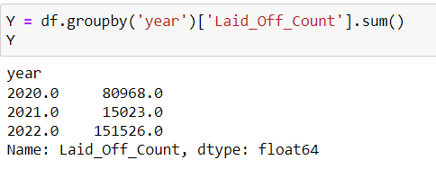
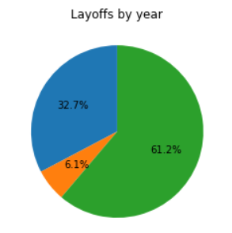

Data Visualization
Data visualization is the graphical representation of information and data. By using visual elements like charts, graphs, and
maps, data visualization tools provide an accessible way to see and understand trends, outliers, and patterns in data.

Slide 9
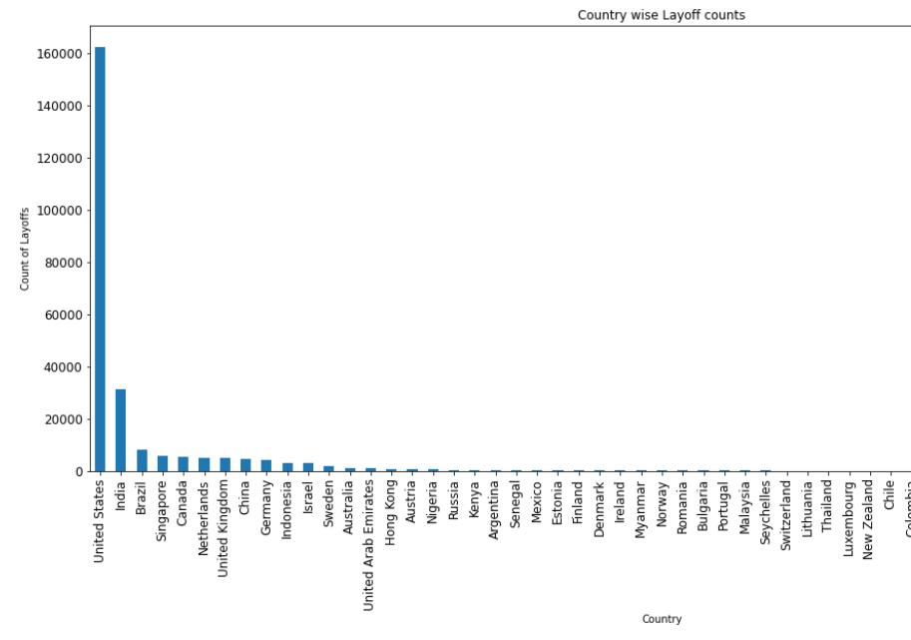

Slide 10
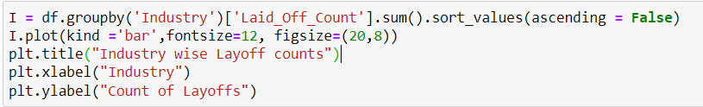
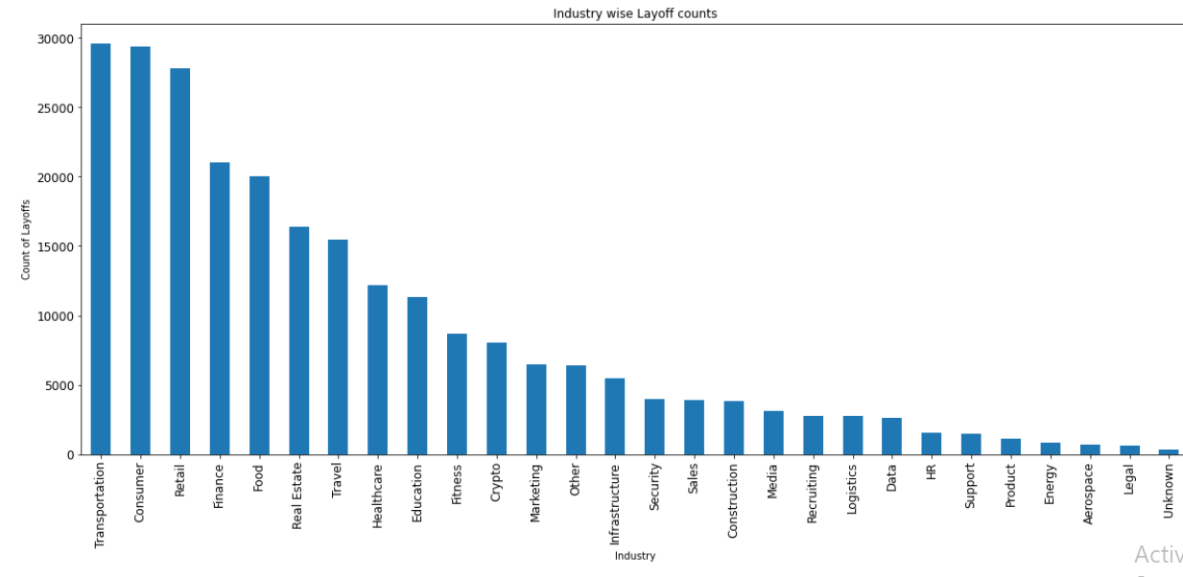

Slide 11
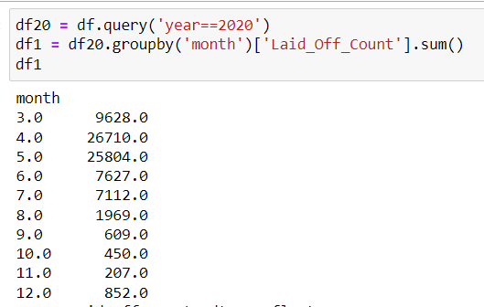
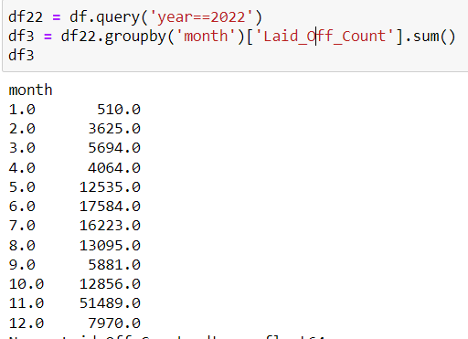
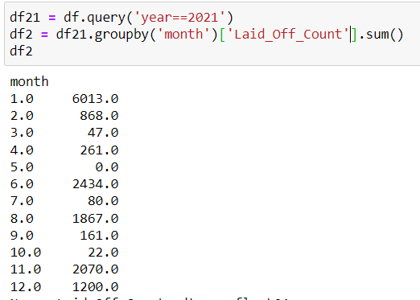
1. Query the year wise layoffs per month and performing sum monthwise.

Slide 12
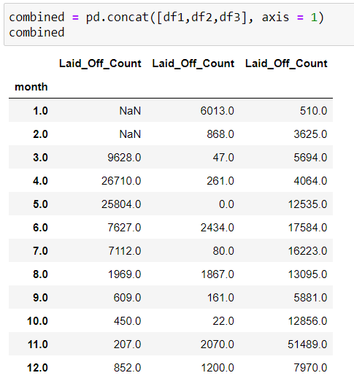
2. Combining the those 3 dataframes.

Slide 13
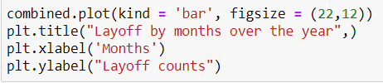
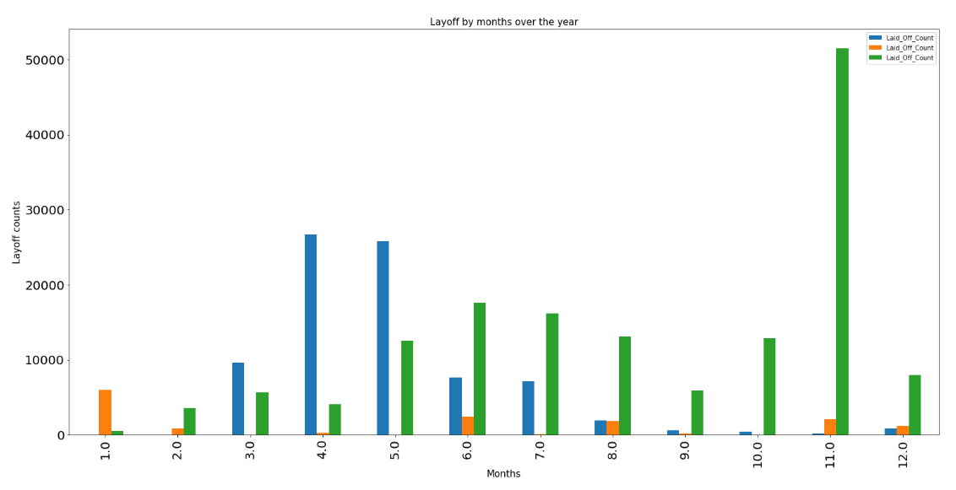
3. Visualizing the data months and yearwise.

Slide 14
Summary
Maximum layoffs are in November 2022.
Maximum layoffs happened in United states and India.
Maximum layoffs happen in Transportation, consumer and retail industries.
Maximum Percentage of layoff employees are from Aerospace and travel.
In 2020 maximum layoffs happened in April and May.

Slide 15
THANK YOU

